Slide 1

Neural network dynamics and modelling of cognitive functions
Dr. KongFatt Wong-Lin
Intelligent Systems Research Centre
School of Computing, Engineering & Intelligent Systems
Ulster University
Magee Campus
Derry~Londonderry
Northern Ireland, UK
26 Oct 2021

Slide 2
Topics:
Neural network dynamics
Modelling (some) cognitive functions
Modelling decision dynamics & AI applications

Slide 3
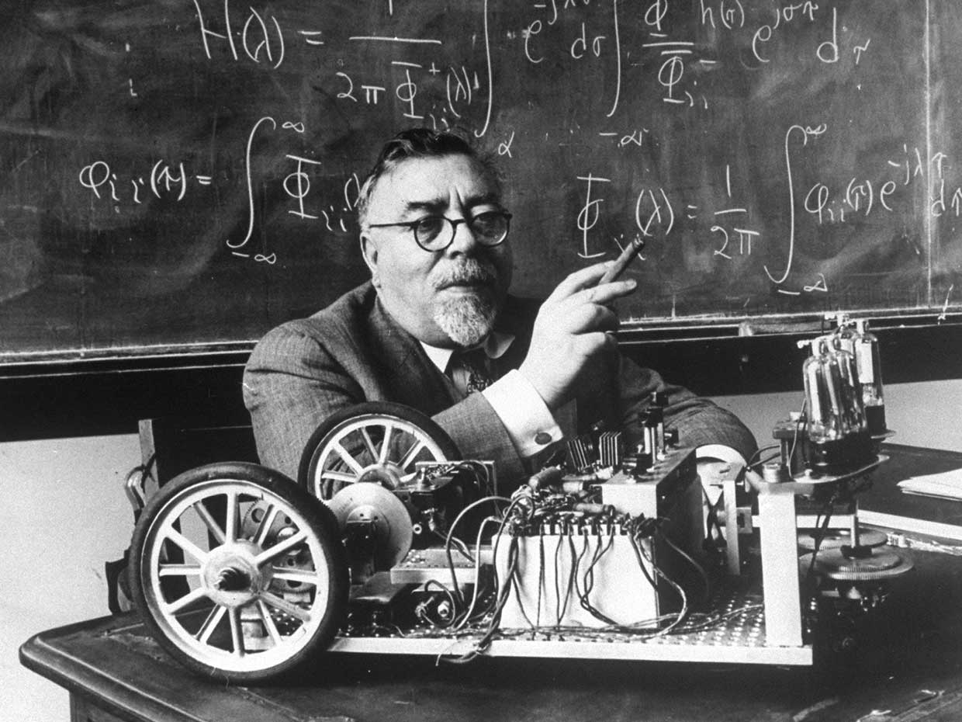
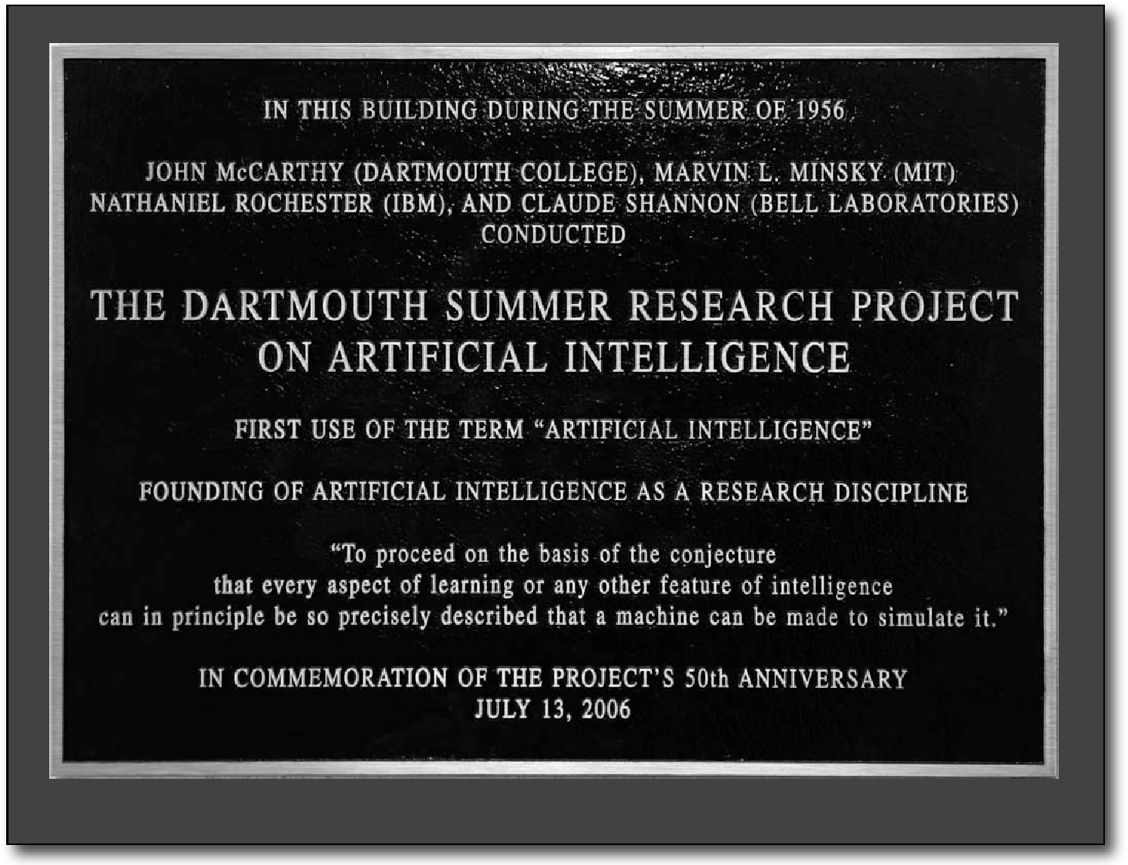
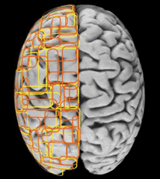
Computational view of cognition
Computational Neuroscience (1980’s)
Cybernetics (1940’s) and Artificial intelligence (AI) (1950’s)
Mathematician Norbert Wiener (with his cybernetic moth-bedbug)
Artificial neural networks & learning algorithms
Biologically based computational & mathematical models

Slide 4
Representation of neural network models
How do we model neural networks?
Ordinary (Partial) Differential Equations (ODEs / PDEs),
be they:
biophysical (HH-type) models,
spiking (IF) neuronal network models, or
simplified neural network models

Slide 5
Are there ways to theoretically analyse and conceptually understand neural networks? Can we use certain network behaviour to model and understand certain cognitive functions or observable behaviour*?
Focus: Network dynamics using the tools in dynamical systems theory (in physics and mathematics), beginning with simple network models
*Note: There are other theoretical approaches to model cognitive functions
Notes:
Instead of training neural network models and apply. Go a different way.

Slide 6
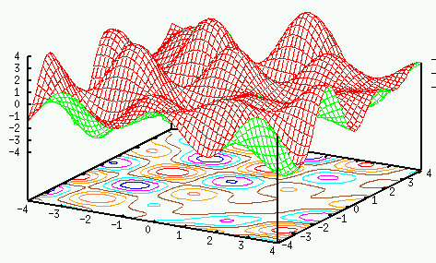
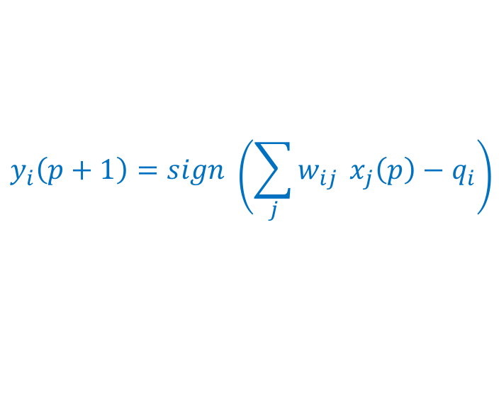
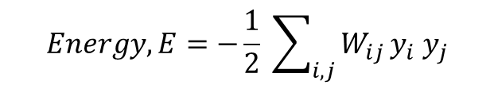
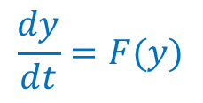
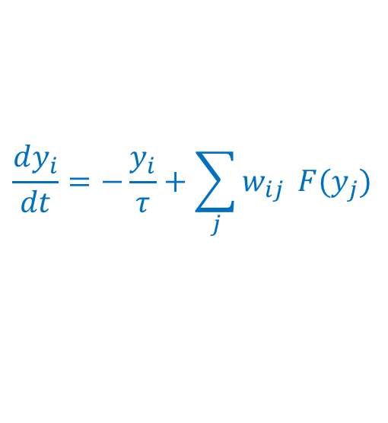
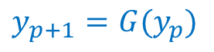
Recall Hopfield network model (for memory)
$$Energy, E=−\frac{1}{2} \sum_{i,j}{W_{ij}}y_{i} y_{j}$$
I n p u t S i g n a l s
O u t p u t S i g n a l s
E
y₂
y₁
Discretized updating of states (p^{th} iteration) Nonlinear map
or
$$y_{i}\left(p+1\right)=sign \left(\sum_{j}{w_{ij}} x_{j}\left(p\right)−q_{i}\right)$$
$$y_{p+1}=G(y_{p})$$
Continuous updating of states (1st order) nonlinear DE
$$\frac{dy_{i}}{dt}=−\frac{y_{i}}{τ}+\sum_{j}{w_{ij}} F(y_{j})$$
or
$$\frac{dy}{dt}=F(y)$$
Notes:
Rate of change

Slide 7
Generic Representation & Behaviour of Dynamical Systems
Dynamical systems have generic behaviour.
Can be represented in the general forms*:
Discrete maps: x_{p+1} = G(x_{p},π) for discrete dynamics
Differential equations: dx/dt = F(x,π,t) for continuous dynamics
where state vector x = (x₁, x₂, … , x_{n}), and a set of parameters π = (π₁, π₂, … , π_{n}).
*Useful tool for modelling and analysis in many fields(!): physics, engineering, chemistry, biology, computer science, psychology, finance, economics, sociology, management, etc.

Slide 8
Wait a minute… But we’ve previously learned that the activity of neurons come in the form of discrete action potentials or spikes. How can we relate that to a continuous stream of activities of a system of neurons, as in the Hopfield model?

Slide 9
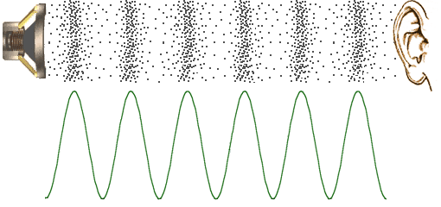
Transforming from discretized to continuous activity
An analogy: from air particle movement to (approximate) continuous sound wave

Slide 10
Transforming from discretized noisy activity (neuronal spike times) to continuous activity (neural population firing rate)
Neuron #
1 2 3 … … n
Spike raster diagram (rastergram)
Frequency (events per time bin)
Histogram
(averaged over some defined small time bin Δt)
“Instantaneous” population firing rate (a continuous approximation)
Firing rate
(spikes/sec or Hz)
Notes:
Approximation works when the network size is very large (theoretically tends to infinity), reducing the amount of correlations among the neurons.
Synapses in network could enhance or decrease spike correlations.

Slide 11
We can also do it for a single (noisy) neuron but averaged over many experimental or simulated trials with the same external stimulus (environment)
Trial #
1 2 3 … … n
Spike raster diagram (rastergram)
Frequency (events per time bin)
Histogram
(averaged over some defined small time bin Δt)
“Instantaneous” neuronal firing rate (a continuous approximation)
Firing rate
(spikes/sec or Hz)

Slide 12
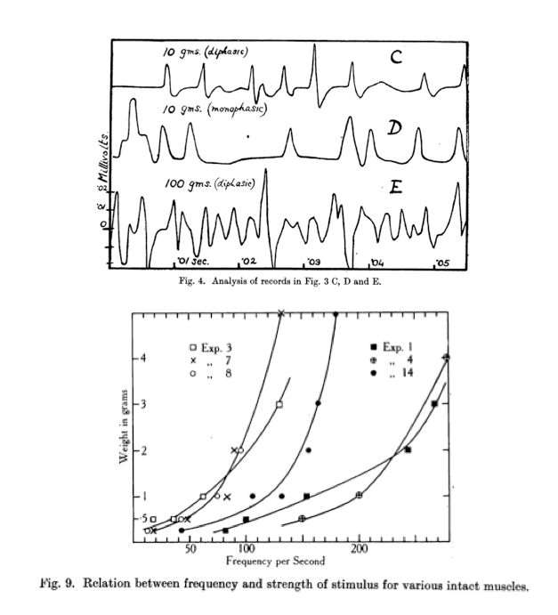
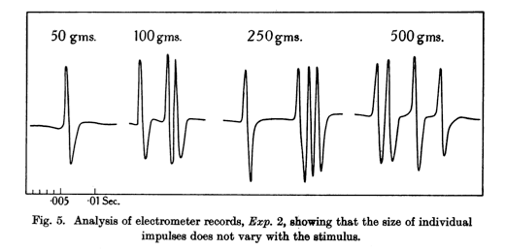
Rate coding – mean, instantaneous firing rates
“Tuning” curves of primary visual cortex
(Hubel and Wiesel)
Arm reaching
Motor preparation and movement
Oculomotor movement
Head direction
Perceptual decision-making
Various forms of memory encoding and retrieval
Many more …
A.D. Adrian (1926)
J. Physiol. (Lond.), 61: 49-72.
Notes:
Focus on rate coding, as compared to individual spiking information

Slide 13
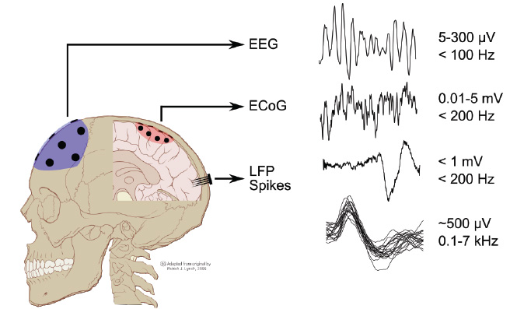
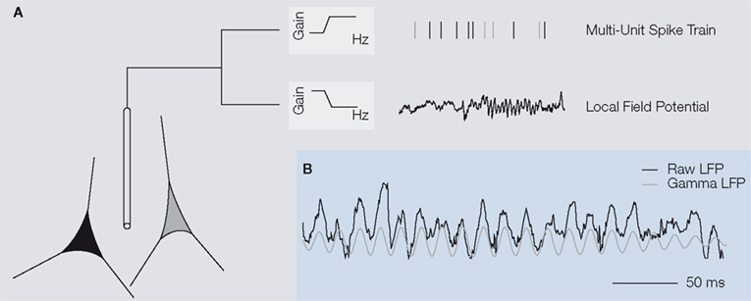
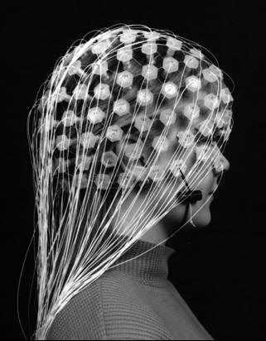
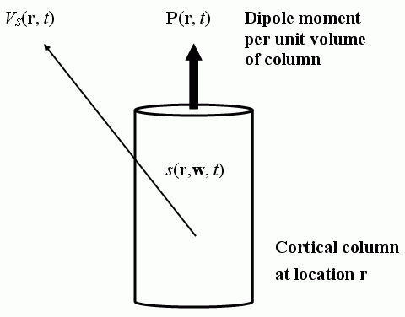
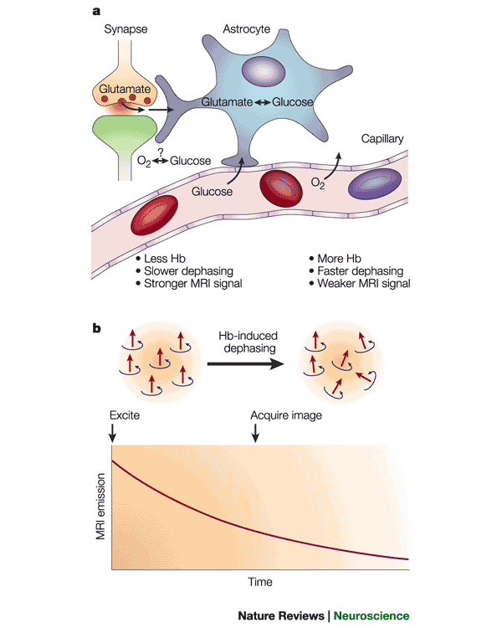
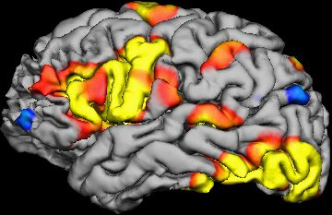
Neural recordings
Local field potential
(LFP; electrical field in extracellular space)
Electrical signals from electroencephalogram (EEG)
(Or magnetic signals with MEG)
Functional MRI (fMRI) BOLD signals
Heeger and Ress, Nat. Rev. Neurosci., 2002.
BOLD: Blood oxygen level dependent
http://www.scholarpedia.org/article/Local_field_potential
http://www.scholarpedia.org/article/Electroencephalogram
http://en.wikipedia.org/wiki/Blood-oxygen-level_dependent
Notes:
Firing rates of neurons can also be converted to model LFP, EEG, fMRI BOLD signals

Slide 14
Computationally, firing-rate models are more efficient – do not have to simulate every single neuronal spiking. Just treat activity as continuous function and averaged over population of neurons.
Firing-rate network models can be analytically tractable, and hence more conducive for analytical understanding of network behaviour, and hence cognitive processes.
Firing-rate models are used in most artificial neural networks including deep learning.

Slide 15
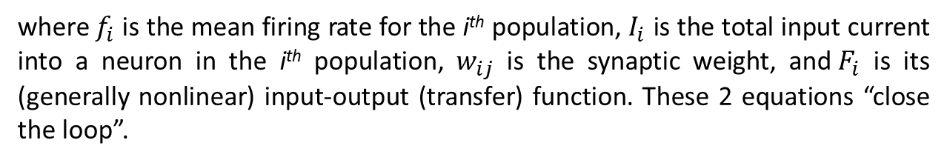
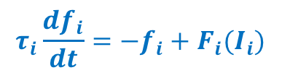
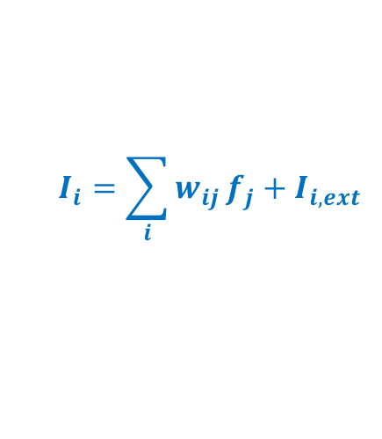
Firing-rate (rate) models
The instantaneous firing rate for a homogeneous population of neurons can be described by :
$$τ_{i}\frac{df_{i}}{dt}=−f_{i}+F_{i}(I_{i})$$
$$I_{i}=\sum_{i}{w_{ij}}f_{j}+I_{i,ext}$$
where${ f}_{i}$ is the mean firing rate for the i^{th} population,${ I}_{i}$ is the total input current into a neuron in the i^{th} population, $w_{ij}$ is the synaptic weight, and${ F}_{i}$ is its (generally nonlinear) input-output (transfer) function. These 2 equations “close the loop”.
Wilson and Cowan, 1972; 1973
Sometimes, the mean membrane potential <V_{i}> is used instead of current${ I}_{i}$.
Among the most influential theoretical neuroscience papers:
Wilson and Cowan (1972) Excitatory and inhibitory interactions in localized populations of model neurons. Biophysical Journal 12:1-24.
Wilson and Cowan (1973) A mathematical theory of the functional dynamics of cortical and thalamic nervous tissue. Kybernetik 13:33-80.

Slide 16
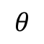
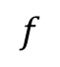

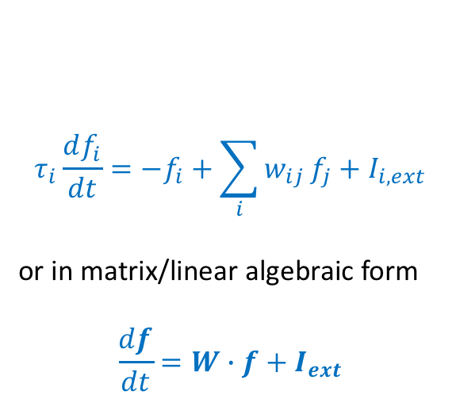
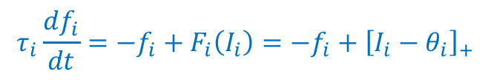
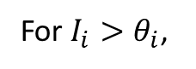
For a simple “threshold-linear” input-output (transfer) function,
$$f$$
$$τ_{i}\frac{df_{i}}{dt}=−f_{i}+F_{i}\left(I_{i}\right)=−f_{i}+{\left[I_{i}−θ_{i}\right]}_{+}$$
$$I$$
$$θ$$
$$τ_{i}\frac{df_{i}}{dt}=−f_{i}+\sum_{i}{w_{ij}}f_{j}+I_{i,ext}$$
or in matrix/linear algebraic form
$$\frac{df}{dt}=W∙f+I_{ext}$$
For $I_{i}>θ_{i}$,
Fully linear
where $f$ and $I_{ext}$ are vector columns, and $W$ is ($−𝕀+w_{ij}$) a matrix.
Notes:
Other names: neural mass models

Slide 17
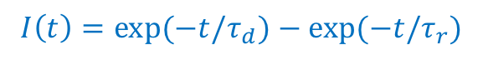
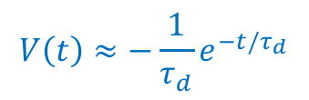
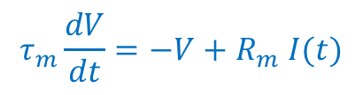
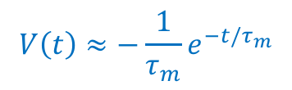
Heuristic derivations (multiple timescale system)
Suppose a simple (passive) neuronal membrane potential which can be described by:
$$τ_{m}\frac{dV}{dt}=−V+R_{m} I(t)$$
and if the afferent current is described by a sum of 2 exponentials,
$$I\left(t\right)=\exp{(−t/τ_{d})}−\exp{(−t/τ_{r})}$$
Assuming the initial membrane potential is zero, i.e. $V\left(0\right)=0$, then the solution is:
$$V\left(t\right)=\frac{τ_{d}}{τ_{d}−τ_{m}}\left(e^{−t/τ_{d}}−e^{−t/τ_{m}}\right)−\frac{τ_{r}}{τ_{r}−τ_{m}}\left(e^{−t/τ_{r}}−e^{−t/τ_{m}}\right)$$
$$V\left(t\right)≈−\frac{1}{τ_{m}}e^{−t/τ_{m}}$$
Case I: For τ_{m} >> τ_{d} >> τ_{r}
$$V\left(t\right)≈−\frac{1}{τ_{d}}e^{−t/τ_{d}}$$
Case II: For τ_{m} << τ_{d} ,
τ_{m} & τ_{d} >> τ_{r}

Slide 18
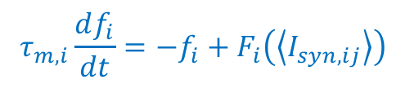
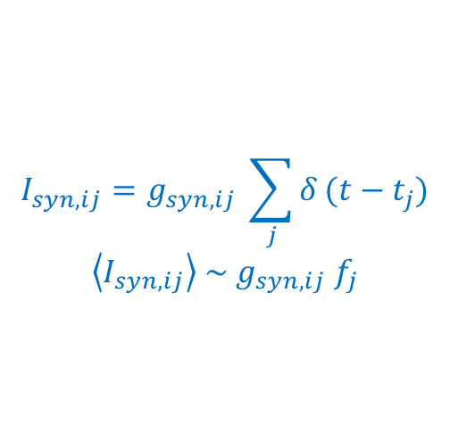
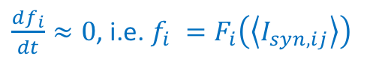
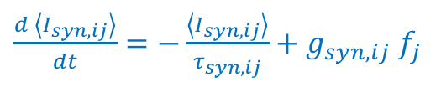
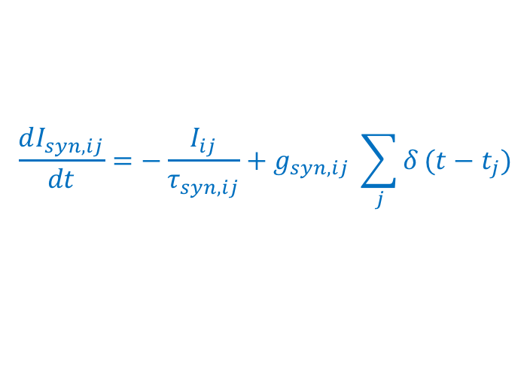
Heuristic derivations (multiple timescale system)
In firing-rate models
$$I_{syn,ij}=g_{syn,ij} \sum_{j}{δ}(t−t_{j})$$
$$\left\langle I_{syn,ij}\right\rangle \sim g_{syn,ij} f_{j}$$
Instantaneous synapses
Case I: For τ_{m} >> τ_{syn}
Averaged over neurons
$$τ_{m,i}\frac{df_{i}}{dt}=−f_{i}+F_{i}\left(\left\langle I_{syn,ij}\right\rangle \right)$$
Governed by membrane potential dynamics
Case II: For τ_{m} << τ_{syn}
we cannot ignore synaptic dynamics
$$\frac{dI_{syn,ij}}{dt}=−\frac{I_{ij}}{τ_{syn,ij}}+g_{syn,ij} \sum_{j}{δ}(t−t_{j})$$
$\frac{d \left\langle I_{syn,ij}\right\rangle }{dt}=−\frac{\left\langle I_{syn,ij}\right\rangle }{τ_{syn,ij}}+g_{syn,ij}$ $f_{j}$
while
$\frac{df_{i}}{dt}≈0$, i.e. $f_{i} =F_{i}\left(\left\langle I_{syn,ij}\right\rangle \right)$

Slide 19
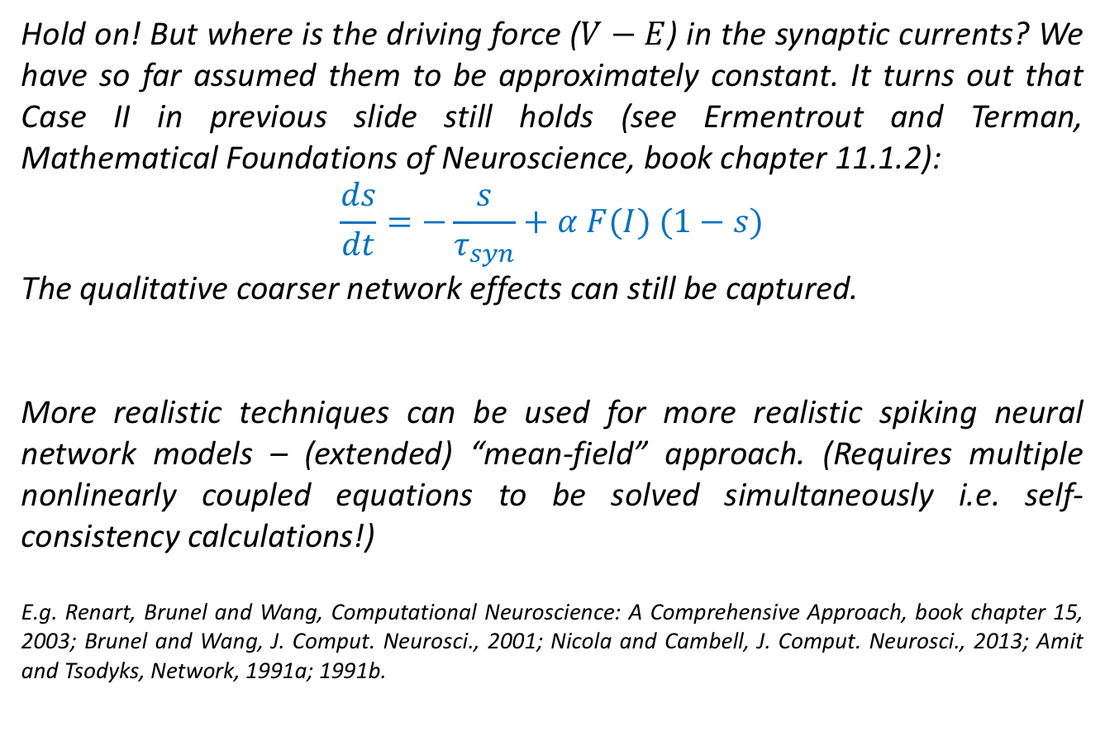
Hold on! But where is the driving force ($V−E$) in the synaptic currents? We have so far assumed them to be approximately constant. It turns out that Case II in previous slide still holds (see Ermentrout and Terman, Mathematical Foundations of Neuroscience, book chapter 11.1.2):
$$\frac{ds}{dt}=−\frac{s}{τ_{syn}}+α F(I) (1−s)$$
The qualitative coarser network effects can still be captured.
More realistic techniques can be used for more realistic spiking neural network models – (extended) “mean-field” approach. (Requires multiple nonlinearly coupled equations to be solved simultaneously i.e. self-consistency calculations!)
E.g. Renart, Brunel and Wang, Computational Neuroscience: A Comprehensive Approach, book chapter 15, 2003; Brunel and Wang, J. Comput. Neurosci., 2001; Nicola and Cambell, J. Comput. Neurosci., 2013; Amit and Tsodyks, Network, 1991a; 1991b.

Slide 20

A (homogeneous) population of neurons recurrently connected – an autapse
The simplest recurrent neural network model
≈
“Autapse (auto-synapse)”: effectively a “self-connected” system. The simplest recurrent neural network.

Slide 21
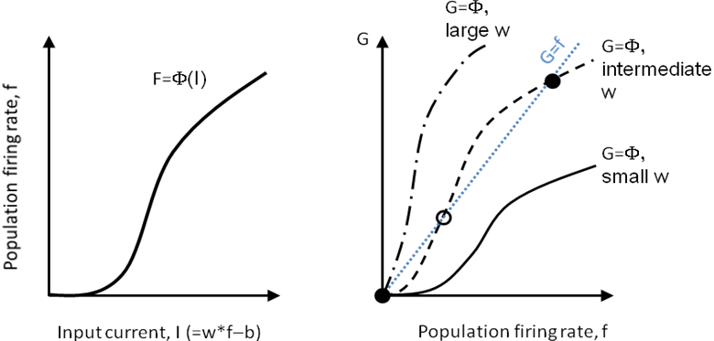
Multi-stability for memory encoding
Categorical (discretized) memory
W
τ df/dt = −f + F(I)
f
Suppose F is a nonlinear input-output function F (e.g. a sigmoidal function) as shown in the left figure. At steady state, df/dt = 0, which means the firing rate f = F(Wf - b). When (function) F is plotted as a function against (variable) f, the intersection points between the functions G = f (i.e. diagonal line) and G = F will produce the steady states of the system – by definition.
Because of the structure of the nonlinear function, there can be a coexistence of 2 stable steady states plus 1 unstable steady state. This emergent bi-stable properties allows the system to store memory at the higher stable (or “up”) steady state. In this simple model, the bi-stable network can only be achieved if the synaptic weight W is sufficiently large enough, i.e. recurrent excitation has to be strong. A too strong (weak) recurrent strength will result in only a single high (low) stable steady state, thus unable to store any useful memory (right figure). A specific example of such system: a homogeneous population of neurons in a Hopfield network model encoding a specific memory state.

Slide 22
“Working” memory: remembering a brief stimulus
Effective input-output function:
Sufficiently strong recurrent excitation → “kinks”
Weak recurrent excitation
Bistable
f
f
I
I

Slide 23
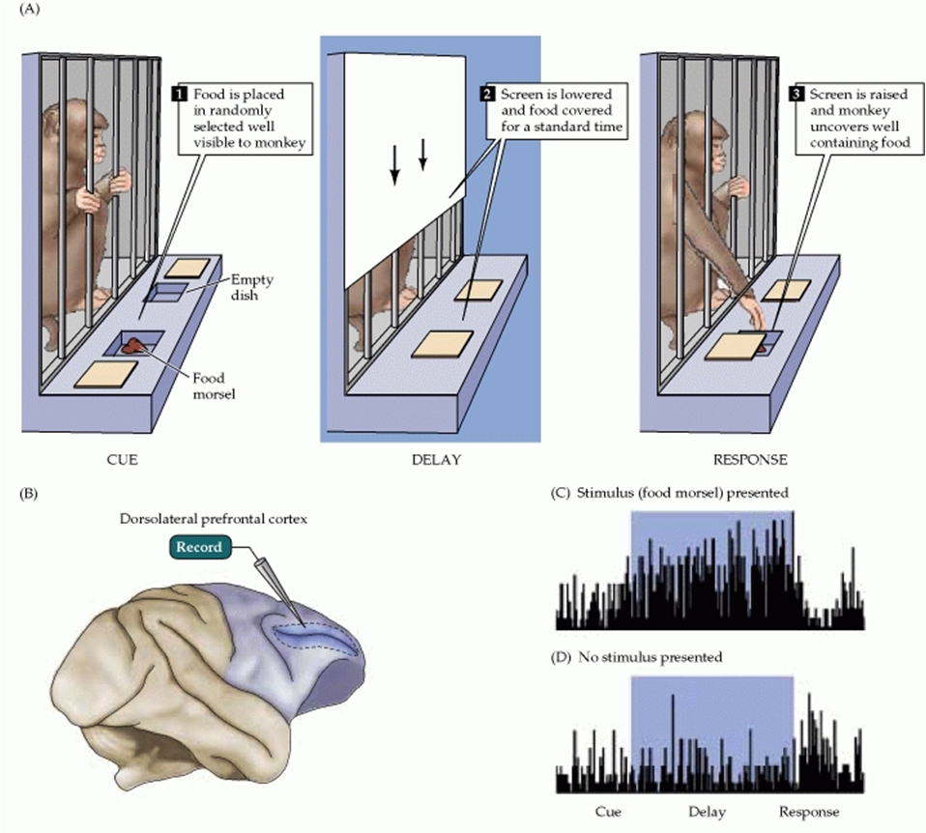
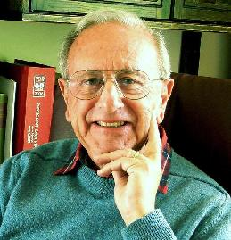
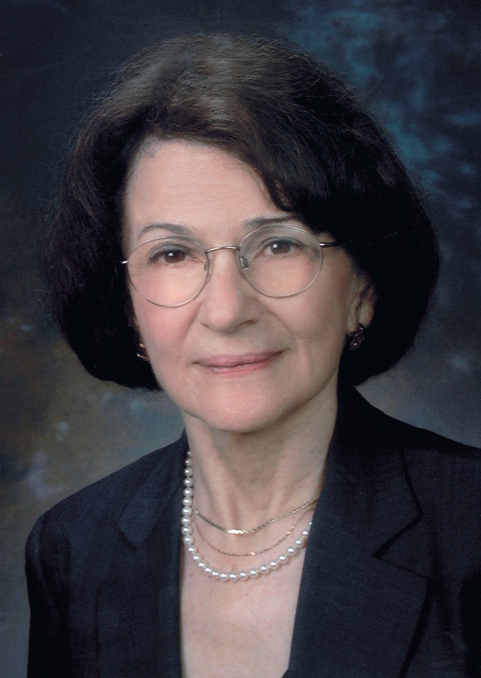
Persistent activity during delay period
Joaquin Fuster
Patricia Goldman-Rakic

Slide 24
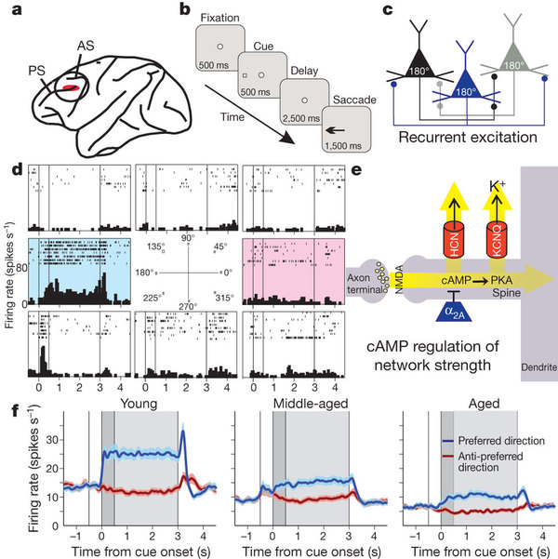
Spatial working
memory
Wang, Gamo, et al., Nature, 2010

Slide 25
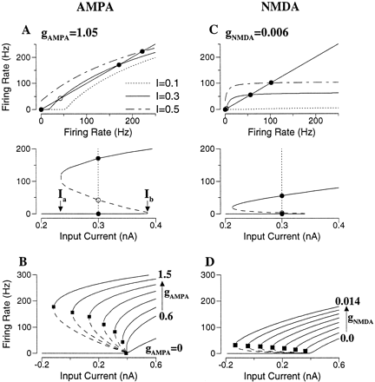
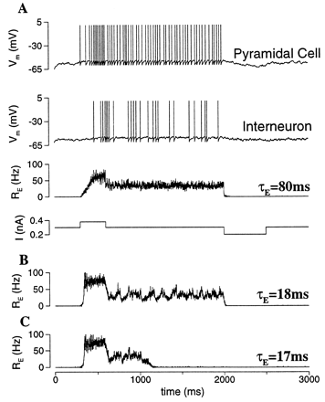
Importance of slow NMDA-mediated synapses for reliable persistent activity
X-J Wang, J. Neurosci., 1999

Slide 26
What if the input-output function F is linear?
Parametric (continuous) memory
Sufficiently strong recurrent excitation, i.e. memorise continuous values perfectly
Weak recurrent excitation
f
f
F
A locus of stable points for
any input I!
I
I

Slide 27
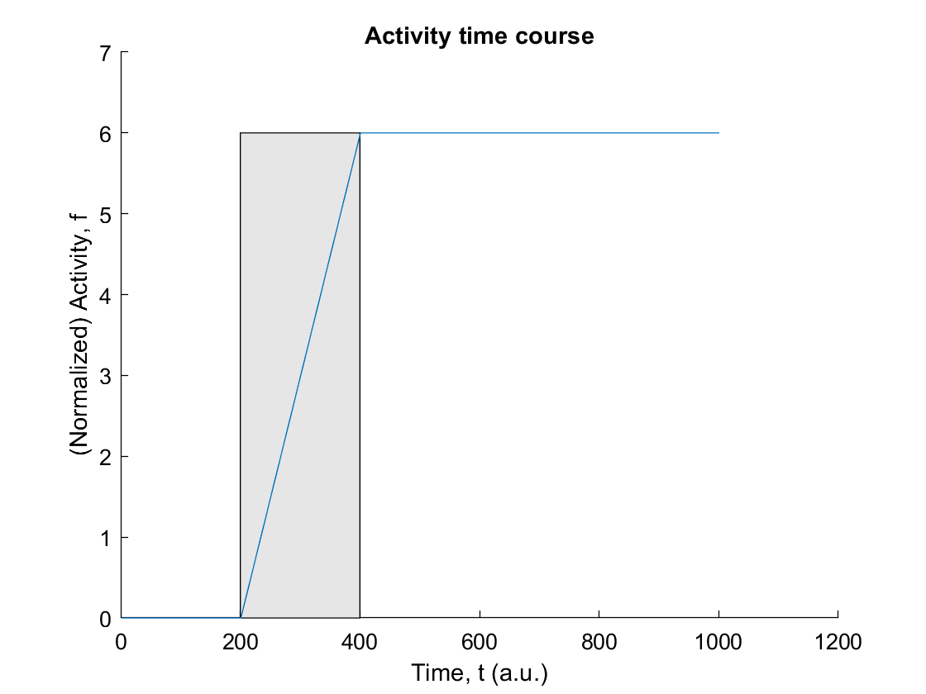
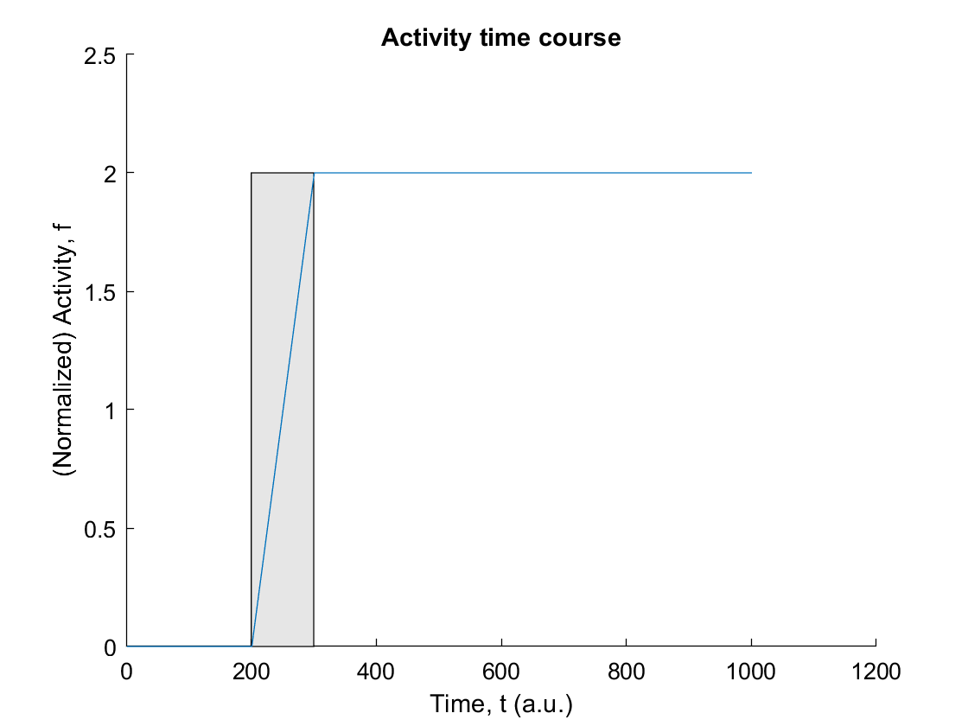
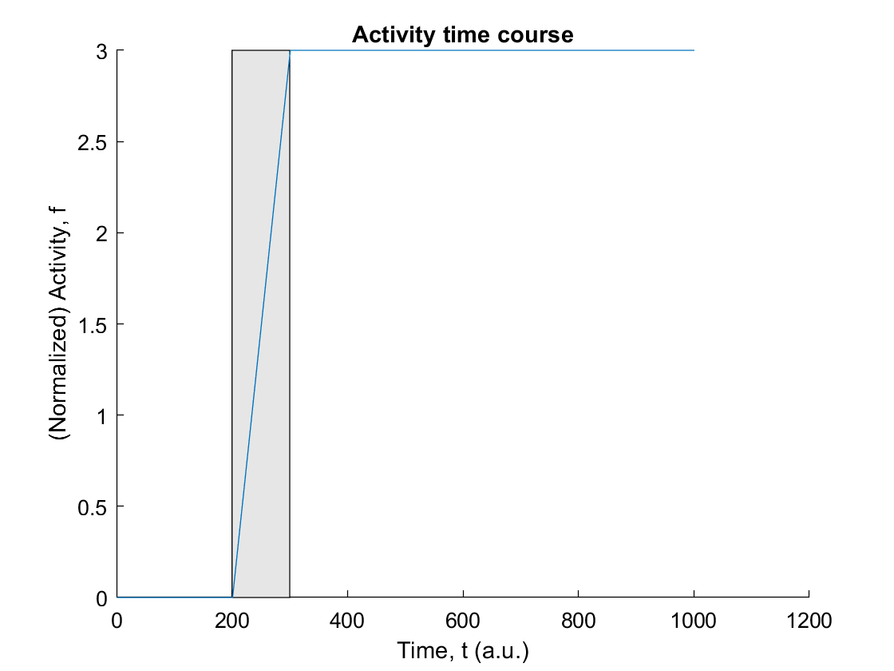
What if the input-output function F is linear?
Parametric (continuous) memory
Input: 0.2
Duration: 100
Input: 0.3
Duration: 100
Input: 0.3
Duration: 200

Slide 28
Multi-stability for memory encoding
Parametric (continuous) memory
Derivation
Suppose F is instead linear, then τ df/dt = - f + (Wf + b) = (W - 1)f + b, absorbing the leak term.
If W > 1, then (W - 1) > 0, and the solution f amplifies exponentially without any upper bound, i.e. f keeps growing.
If W < 1, then (W - 1) < 0, and the solution f can reach a certain stable steady state, obtained by setting df/dt = 0: (1 - W)f = b or
f_{ss} = b/(1 - W)
Thus, if 0 < W < 1, the network can reach a steady state level which is dependent on not only the input, but can be amplified if W is closed to but smaller than 1. Furthermore, the time (constant) to reach this steady state is also dependent on W. Rewriting the equation,
τ/(1 - W) df/dt = f + b/(1 - W)
one can see that the effective time constant
τ_{eff} = τ/(1 - W),
and if W is closed to 1, the dynamics will be very slow.
If W = 1, then (W - 1) = 0, and the solution f can integrate information (in the form of afferent/biased input b) perfectly (i.e. no loss of information):
τ df/dt = b or f = (b/τ)t + constant
Notes:
Skip

Slide 29
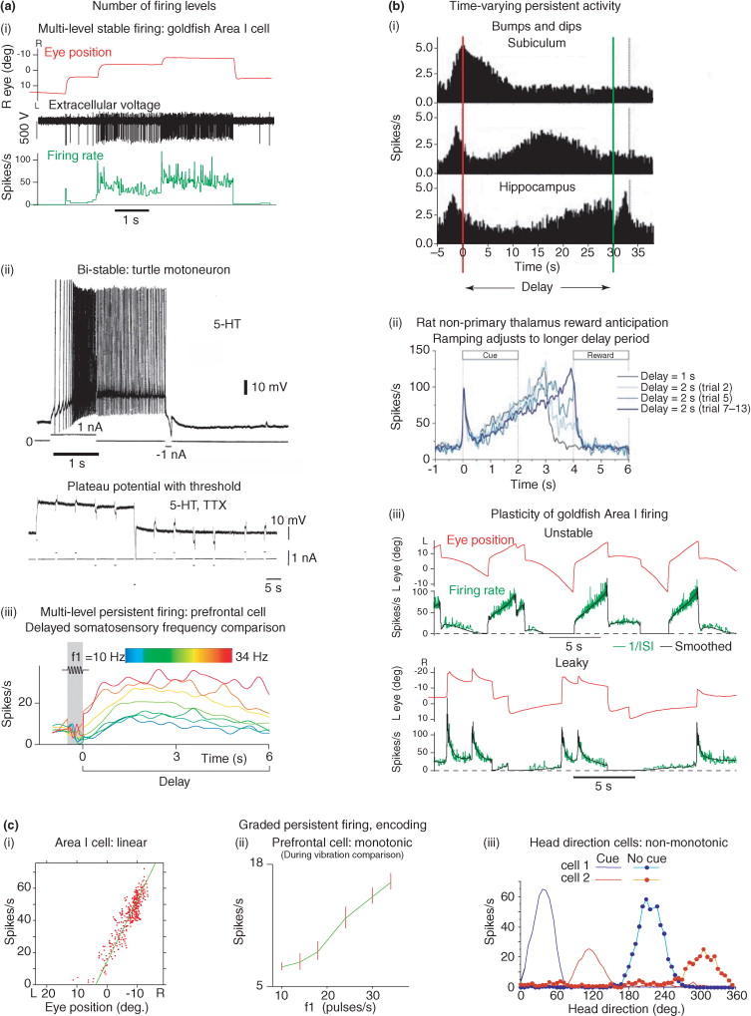
Characteristics of different kinds of persistent neural activity.
Major and Tank, Curr. Opin. Neurobiol., 2004

Slide 30
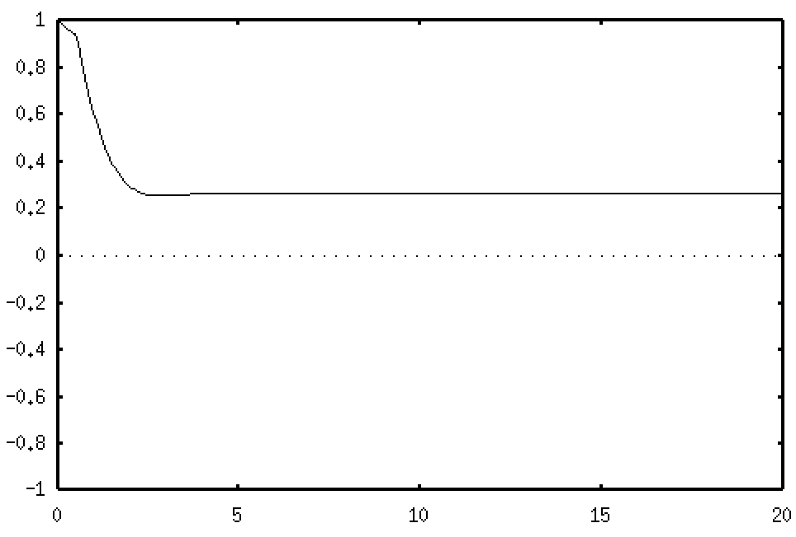
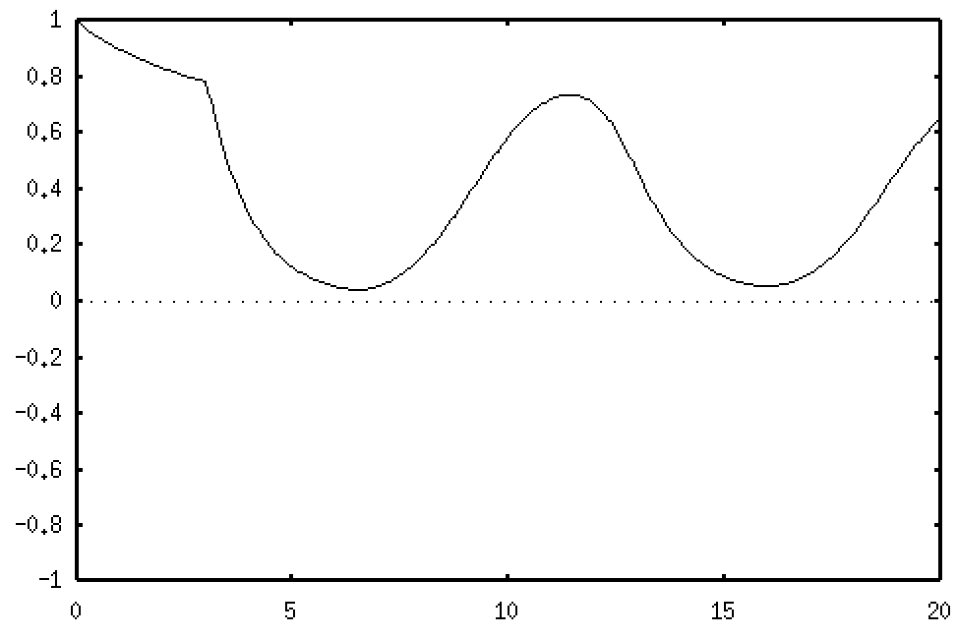
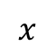






Example: A simple self-inhibitory feedback population of neurons with time delay
$$\frac{dx}{dt}=−x+f(x−τ)$$
W
$$f\left(x\right)=\frac{1}{1+\exp\left(−x\right)}$$
f
For some inhibitory feedback delay of time $τ$
$$x$$
Fast feedback
Slow feedback
$$τ=0.5 (a.u.)$$
$$τ=3.0 (a.u.)$$
Time $t$ (a.u.)
Notes:
Fake oscillations occur due to poor numerical integration scheme – using too large a time bin for numerical integration

Slide 31
What if we have 2 populations of neurons interacting?

Slide 32


Refresher: Complex numbers
i² = −1 or i =$\sqrt{−1}$
In general: x + iy where x is real (Re) while iy is imaginary (Im)
Re
Im
Geometric representation: Complex plane
Imaginary numbers, useful for the construction of non-real complex numbers, have essential concrete applications in a variety of scientific and related areas such as dynamical systems theory, signal processing, control theory, electromagnetism, fluid dynamics, quantum mechanics, cartography, and vibration analysis.

Slide 33






Example: Stability and state space in 2-dimensional linear systems.
df/dt = W●f + B, where f=(f₁, f₂), absorbing the leak term and the time constant.
W₁₁
W₂₁
W₂₂
$$\frac{d}{dt}\left[\begin{matrix}f_{1} \\ f_{2}\end{matrix}\right]=\left[\begin{matrix}F(f_{1},f_{2}) \\ G(f_{1},f_{2})\end{matrix}\right]$$
2 coupled equations
in matrix form
f₁
f₂
Jacobian matrix, $J=\left[\begin{matrix}\frac{∂F_{1}}{∂f_{1}} & \frac{∂F_{1}}{∂f_{2}} \\ \frac{∂F_{2}}{∂f_{1}} & \frac{∂F_{2}}{∂f_{2}}\end{matrix}\right]$
W₁₂
evaluated at steady state $\left({f_{1}}^{∗}, {f_{2}}^{∗}\right)$
For linear coupled equations in matrix form
f₁
W₁₁
W₁₂
f₁
b₁
$$J=\left[\begin{matrix}\frac{∂(W_{11}f_{1}+W_{12}f_{2})}{∂f_{1}} & \frac{∂(W_{11}f_{1}+W_{12}f_{2})}{∂f_{2}} \\ \frac{∂(W_{21}f_{1}+W_{22}f_{2})}{∂f_{1}} & \frac{∂(W_{21}f_{1}+W_{22}f_{2})}{∂f_{2}}\end{matrix}\right]$$
$$\frac{d}{dt}$$
=
+
f₂
W₂₁
W₂₂
f₂
b₂
First note that we can always define a new set of coordinates such that the “origin” lies on (b₁, b₂). This simplifies the equation to df/dt = W●f. Then determine the steady states of the system by setting df/dt = 0. Next, find the Jacobian matrix $J$ of matrix W at the steady state. The stability of the system will depend on the characteristics of the eigenvalues of this Jacobian matrix at the steady state.

Slide 34
In 2-D phase space, there are 4 cases:
Spiral point, which can result in damped (or amplifying) oscillation of the system. Requires the eigenvalues to be both real (both negative for damped, and positive for amplifying) and non-zero imaginary parts;
Node, which can result in strictly attracting towards (or repelling away) from certain activity level. Requires both eigenvalue to be strictly negative (or positive) with no imaginary parts;
Saddle point, which can result in a mixture of attracting and repelling dynamics. Requires one eigenvalue to be strictly positive and the other negative, none with imaginary parts;
Center, which can result in oscillatory behaviour. Requires both eigenvalues to be strictly imaginary with no real parts.

Slide 35
Stability and state space in 2-dimensional linear systems.
df/dt = W●f + B, f=(f₁, f₂). 2-D systems have 2 eigenvalues and 2 eigenvectors.
(i)
Spiral point
(ii)
Node
f₂
f₂
λ₁ = c+id
λ₂ = c-id
λ₁ < 0 (real)
λ₂ < 0 (real)
f₁
f₁
(iii)
Saddle point
(iv)
Centre
f₂
f₂
λ₁ < 0 (real)
λ₂ > 0 (real)
λ₁ imaginary
λ₂ imaginary
f₁
f₁
Typical phase plane trajectories for the 4 characteristics equilibrium points (steady states)
Notes:
Note: the dash lines are nullclines, by setting each equation to zero and solving one variable e.g. f_1 as function of another other f_2

Slide 36
Examples of activity time courses in 2-dimensional linear systems df/dt = A●f + B, f=(f₁, f₂)
Spiral point (damped oscillation)
Node (stable fixed point)
f₁
f₁
t
t
Saddle point
Centre (oscillation)
f₁
f₁
t
t

Slide 37
Possible functions?
Stable node: Storing information for cognitive tasks. Short-term or long-term memory; decisions.
Oscillation (centre): Timing; integration through binding of information; motor activity or locomotion (central pattern generators); perceptual rivalry; computational neuroimaging.
Metastable (saddle): Creates barrier between cognitive (e.g. memory) states; decision dynamics.

Slide 38

Example: Nonlinear gain control in amacrine cell feedback onto bipolar cells in primate and human retinas (Wilson, Visual Neurosci., 1997).
Retina
Light
B
A

Slide 39





Example: Nonlinear gain control in amacrine cell feedback onto bipolar cells in primate and human retinas (Wilson, Visual Neurosci., 1997).
Let B be the bipolar cell response to light level L and A the amacrine cell response:
$$\frac{dB}{dt}=\frac{1}{τ_{B}}\left(−B+\frac{L}{1+A}\right)$$
$$\frac{dA}{dt}=\frac{1}{τ_{A}}\left(−A+2B\right)$$
Setting the light level L=10, the steady state is $\left(A^{∗}, B^{∗}\right)=(4, 2)$
$$J=\left[\begin{matrix}\frac{∂}{∂B}\left(\frac{1}{τ_{B}}\left(−B+\frac{L}{1+A}\right)\right) & \frac{∂}{∂A}\left(\frac{1}{τ_{B}}\left(−B+\frac{L}{1+A}\right)\right) \\ \frac{d}{dB}\left(\frac{1}{τ_{A}}\left(−A+2B\right)\right) & \frac{d}{dA}\left(\frac{1}{τ_{A}}\left(−A+2B\right)\right)\end{matrix}\right]$$
The Jacobian matrix is
$$J=\left[\begin{matrix}−\frac{1}{τ_{B}} & −\frac{L}{τ_{B}}\frac{1}{{(1+A)}^{2}} \\ \frac{2}{τ_{A}} & −\frac{1}{τ_{A}}\end{matrix}\right]=\left[\begin{matrix}−\frac{1}{10} & −\frac{1}{25} \\ \frac{1}{5} & −\frac{1}{10}\end{matrix}\right]$$
If time constants $τ_{A}$and $τ_{B}$are 10 ms

Slide 40

Example: Nonlinear gain control in amacrine cell feedback onto bipolar cells in primate and human retinas (Wilson, Visual Neurosci., 1997).
The eigenvalues of $J$ are found to be $λ=−0.1±0.089 i$
Repeat for different light level $L$.
B
L=100
L=10
t
~ 10 ms

Slide 41
Technique can be extended to N>2 dimensional coupled systems

Slide 42
What if the system is nonlinear?
We can still use the same technique (linear stability analysis) as for linear system – It turns out that according to a mathematical theorem, the stability of a nonlinear system’s dynamics sufficiently near a steady state is the same as the linear system near the same steady state!
But we may also need to look at the global dynamics which may not be captured by local dynamics.

Slide 43

Example: Excitatory-inhibitory networks
Cartoon rep. of cortical columns
Excitatory neuron
Inhibitory neuron

Slide 44
Example: Excitatory-inhibitory networks
A simplified network architecture (assuming homogenous neurons)
Excitatory neural population
Inhibitory neural population
Notes:
“subsampling” Wallen, Ekeberg, et al., 1992

Slide 45


What kind of dynamics can an excitatory-inhibitory coupled network produce?
$$\frac{d}{dt}\left[\begin{matrix}f_{1} \\ f_{2}\end{matrix}\right]=\left[\begin{matrix}F(f_{1},f_{2}) \\ G(f_{1},f_{2})\end{matrix}\right]$$
W₁₁
W₂₁
W₂₂
f₁
f₂
$$\frac{d}{dt}$$
f₁
W₁₁
W₁₂
f₁
b₁
=
+
W₁₂
f₂
W₂₁
W₂₂
f₂
b₂
Suppose f₁ is an excitatory population of neurons, and f₂ an inhibitory population of neurons, then
W₁₁ > 0, W₁₂ < 0, W₂₁ > 0, W₂₂ < 0
Dale’s principle:
a neuron performs the same chemical action at all of its synaptic connections to other cells, regardless of the identity of the target cell.

Slide 46

What kind of dynamics can an excitatory-inhibitory coupled network produce?
$$\frac{d}{dt}\left[\begin{matrix}f_{1} \\ f_{2}\end{matrix}\right]=\left[\begin{matrix}F(f_{1},f_{2}) \\ G(f_{1},f_{2})\end{matrix}\right]$$
W₁₁
W₂₁
W₂₂
f₁
f₂
$$\frac{d}{dt}$$
f₁
W₁₁
W₁₂
f₁
b₁
=
+
W₁₂
f₂
W₂₁
W₂₂
f₂
b₂
df₂ /dt = 0
f₁
Linear
nullclines
f₂
df₁ /dt = 0

Slide 47



W₂₁ > 0, W₁₂ < 0
Weak W₁₁ > 0, W₂₂ < 0
Nonlinear nullclines
(blue and red lines):
Obtained by algebraically solving each differential equation
$$f_{2}$$
$$f_{1}$$
Excitatory-inhibitory network (Wilson-Cowan type)
With vector field
(used XPPAUT software)
http://www.math.pitt.edu/~bard/xpp/xpp.html

Slide 48

Example: Filtering of fast sensory inputs in whisker barrels of rat
(layer 4 in somatosensory cortex)
W₁₁
W₂₁
W₂₂
If excitation is faster than inhibition,
faster sensory stimuli cause bigger neural responses
f₁
f₂
W₁₂
Thalamus

Slide 49








Mutually
Inhibitory
neural
units
W₁₂ > 0, W₂₁ > 0
W₁₂ > 0, W₂₁ > 0
Weak W₁₁ > 0, W₂₂ > 0
Strong W₁₁ > 0, W₂₂ > 0
$$f_{2}$$
$$f_{2}$$
$$f_{1}$$
$$f_{1}$$
Mutual excitation with weak self-connections
Mutual excitation with strong self-connections
W₁₂ < 0, W₂₁ < 0
W₁₂ < 0, W₂₁ < 0
Strong W₁₁ > 0, W₂₂ > 0
Weak W₁₁ > 0, W₂₂ > 0
$$f_{2}$$
$$f_{2}$$
$$f_{1}$$
$$f_{1}$$
Mutual inhibition with strong self-connections
Mutual inhibition with weak self-connections
Note: The right balance of input currents and connection weights are required.

Slide 50


Example: Perceptual oscillations – Binocular rivalry
Multiple states of the mind
(for the same stimulus)
Necker cube

Slide 51



Binocular rivalry: A phenomenon of visual perception in which perception alternates between different images presented to each eye.
http://www.scholarpedia.org/article/Binocular_rivalry

Slide 52
A basic model for perceptual alternation phenomenon
Mutual (effectively) inhibitory population
- Implicitly incorporate inhibitory populations
Assume some slow adaption neural mechanism, A (=> 4 dyn equations)
df/dt = -f + F(W, A, B)
dA/dt = -A + βf

Slide 53




A basic model for perceptual alternation phenomenon

Slide 54
Are there other types of neural network dynamics?

Slide 55

Landscape metaphors for brain dynamics (A–C). (A) simple attractor (stable fixed point) in the phase space of a dynamical system. (B) a metastable state (saddle fixed point) with two stable and two unstable separatrices (a separatrix is a surface or curve that refers to the boundary separating two modes of behavior in the phase space of a dynamical system). (C) a simple heteroclinic chain with two connected metastable states. (D) a stable heteroclinic channel – robust sequence of metastable states.
Rabinovich MI and Varona P (2011) Robust transient dynamics and brain functions. Front. Comput. Neurosci. 5:24. doi: 10.3389/fncom.2011.00024. Nice not-too-technical review.

Slide 56

Representative examples of dynamical images of brain functions. (1) Rhythmic oscillations (adapted from Gloveli et al., 2005; Walling and Hicks, 2006). (2) Reproducible sequences of taste-specific switching patterns in the gustatory cortex (adapted from (Jones et al., 2007) and heteroclinic channel of saddle cycles (adapted from Rabinovich et al., 2008a). (3) Integration of different modalities – Heteroclinic Binding (Rabinovich et al., 2010a) for mutual modulation of coupled sequential dynamics. (4) Bistability and hysteresis (Jones and Hardy, 1990; Rabinovich et al., 2010b). (5) Low-frequency oscillations and modulational instability in a network with non-symmetric inhibition (WLC; Rabinovich et al., 2010b). (6) Intermittency of sequences (Rabinovich et al., 2010b).
Rabinovich MI and Varona P (2011) Robust transient dynamics and brain functions. Front. Comput. Neurosci. 5:24. doi: 10.3389/fncom.2011.00024

Slide 57


Chaotic (strange) attractor
- Deterministic chaos
Lorenz attractor (3D system)
Period doubling leading to chaos
Frequency
Parameter
Note 1: Confinement within finite space
Note 2: Any neighbouring points will diverge over time
Note 3: All 3 eigenvalues are negative
Model complex or chaotic system (e.g. weather – fluid dynamics, finance, cryptography, robotics).

Slide 58

Transition to periodic oscillations in a chaotic, randomly connected recurrent neural network
Input current suppresses chaotic behaviour
Rajan, Abbott and Sompolinsky (2010)

Slide 59


Excellent performance albeit “strange” behaviour in deep networks
Remarkably good performance
“Double descent” phenomenon e.g. Belkin et al. (2019) (overparametrisation)
Local minima during learning rare as the high-dimensional parameter space consists mostly saddle points e.g. Pascanu et al. (2014) On the saddle point problem for non-convex optimization. arXiv:1405.4604.
Degeneracy of solutions in high dimensions allow faster search for optimal solutions (Bartlett et al. (2019) Benign overfitting in linear regression. arXiv:1906.11300)

Slide 60
References
Hugh R. Wilson, Spikes, Decisions and Actions: Dynamical Foundations of Neuroscience, Oxford University Press, 1999.
From Neuron to Cognition via Computational Neuroscience, Chapters 2, 3 and 11, (M. A. Arbib and J. Bonaiuto) Cambridge, MA: MIT Press (2016).
Dayan and Abbott, Theoretical Neuroscience, chapter 7 “Network models”, MIT Press, 2001.
G. Bard Ermentrout and David H. Terman, Mathematical Foundations of Neuroscience, book chapter 11 “Firing rate models”, Springer, NY, 2010.
H. S. Seung. Amplification, Attenuation, and Integration. In: The Handbook of Brain Theory and Neural Networks: Second Edition (M. A. Arbib, Editor) Cambridge, MA: MIT Press, pp. 94-97 (2003).
Brinkman et al. (2021) Metastable dynamics of neural circuits and networks. arXiv:2110.03025.
Additional:
Steven Strogatz, Nonlinear Dynamics and Chaos: With Applications to Physics, Biology, Chemistry, and Engineering, CRC Press, 2015.
Notes:
Will perhaps hear about metastable states in Scott Kelso’s talk

Slide 61
Notes:
Break for questions before moving to next topic
Focus on decision dynamics

Slide 62
Modelling decision dynamics &
AI applications

Slide 63


Slide 64

Perceptual decision making (under uncertainty)
Integrate sensory information
Select an action/choice among alternative competing options
Respond quickly and/or accurately

Slide 65



A visual motion direction discrimination task
Online psychological experiments
http://epsychology.online
Dr. Angelo Basteris
U. Southern Denmark
Dr. W. Paul Boyce
U. New South Wales

Slide 66
A visual motion direction discrimination task
Online psychological experiments
http://epsychology.online

Slide 67

A visual motion direction discrimination task

Slide 68

A visual motion direction discrimination task
Sample results (psychophysics) from a session
Can we understand the underlying cognitive mechanisms?
Can we build a mathematical/computational model?

Slide 69
Golden age of Mathematical Psychology
(1940’s) …
Coinciding with the maturation of some mathematical (information-theoretic and probabilistic) frameworks to describe individual’s choice behaviour and response times.
… & birth of Decision Sciences

Slide 70
Evidence accumulation
Accumulator models
Decision/reaction time
Decision
threshold/boundary
Internal decision variable, X
Time, t
Sequential sampling model framework

Slide 71




Cognitive model: Drift-diffusion model
Cognitive, mathematical model by Roger Ratcliff (1978) and colleagues
+Z
Decision variable $X$
0
1
-Z
dX = v dt + σ dW
= signal difference + noise
X =
(Stochastic) Calculus

Slide 72








Computer
simulations
With upward
drift rate (overall signal)
Reaction time (RT)
Accuracy =
(No. corrects) / (Total No. choices)
https://www.ejwagenmakers.com/EZ.html

Slide 73
“Biases” in decision making
Threshold
Baseline or starting point
time
time
Growth or ”drift” rate
Shift in onset
time
time
Drift rate and threshold can be time-dependent

Slide 74

Is there evidence in brain physiology of such processes in perceptual decision-making?

Slide 75
Neural correlates of perceptual decision making
Psychological
process
Sensory
processing
Direction of motion
Decision
making
Right or left
Motor
execution
Process “Go” & initate
eye movement
Neural
correlate
Visual
cortex
MT, MST, etc regions
?
Movement
neurons
FEF, SC, etc regions

Slide 76



Brain circuitry controlling (saccadic) eye movements
The search for “neural integrators” in the brain
$$\int{… dt}$$

Slide 77


Classic experiment
Error
Correct
Toward RF
Away RF
Neuronal population in area LIP (lateral intraparietal area)
Roitman & Shadlen, J. Neurosci. (2002)

Slide 78

Recording of a particular (LIP) brain cell in a non-human primate performing motion discrimination task

Slide 79


Similar macroscale brain activity dynamics in humans
Kelly & O’Connell, J. Neurosci. (2013)
Electroencephalography (EEG) measures ensembles of neural activity with high temporal resolution

Slide 80
How to link cognitive models to elements of the brain, i.e. brain cells (neurons) and their connections (synapses)?

Slide 81

A simple neural network model Leaky Competing Accumulator (LCA) model
The decision process as the integration of evidence by competing accumulators – winner-take-all behaviour is necessary, or there will be conflict and indecisiveness.
Usher & McClelland (1995, 2001)
inhibition
S₁
S₂
1
2
leak
leak
inhibition

Slide 82

y₂
Sample simulated trajectory of nonlinear LCA model in phase plane (selecting Choice 1)
Threshold
Choice 2
Threshold
Choice 1
y₁

Slide 83
A multi-population winner-take-all network model
With 2 choices/distractors
(short latency or response time)
Note: The other neural population follows the same dynamics as purple
Hick’s or Hick–Hyman law: Describes the time it takes for a person to make a decision as a result of the possible choices: increasing the number of choices will increase the decision time logarithmically
With 5 choices/distractors
(long latency or response time)
Note: The other 3 neural populations follow the same dynamics as purple
All model parameter values remain the same in both cases.

Slide 84




A network of neurons and emergent behaviour
Spiking activity from a single model neuron, and network of connected neurons
Time
Leaky Integrate-and-fire neuronal model
with realistic synaptic dynamics
dV/dt = −g_{L}(V−E_{L}) + I_{e} − $Σ$g_{s}s(t) (V−E_{s})
Neuronal
membrane
Potential, V
X-J Wang
(2002) Neuron
Time

Slide 85





A “mean-field” (neural population) approach
S
Neural population dynamics described by
r
an approximation of a first passage time formula for LIF neurons (via Fokker-Planck approach), and I is averaged total input to a neuron,
where W is the synaptic (connectivity) strength, and
(Ornstein-Uhlenbeck)
Dynamics describing the averaged synapses (connectivity) for the neural population
for interspike interval distribution ~ Poisson.
Wong & Wang, J. Neurosci. (2006)
Notes:
Skip

Slide 86

Reducing a biophysical model of decision-making
Wong & Wang, J. Neurosci., 2006

Slide 87

A simpler biologically based neural network model
Stimulus off
Stimulus on
Motor
output
for choice 1
Motor
output
for choice 2
Cells responding to choice 1
Cells responding to choice 2
Sensory
input
favouring
choice 1
Sensory
input
favouring
choice 2
Choice 2
Choice 1
Wong and Wang, J. Neurosci. (2006)
Roxin and Ledberg, PLoS Comput. Biol. (2008)

Slide 88

A simpler biologically based neural network model
Stimulus off
Stimulus on
Motor
output
for choice 1
Motor
output
for choice 2
Cells responding to choice 1
Cells responding to choice 2
Sensory
input
favouring
choice 1
Sensory
input
favouring
choice 2
Choice 2
Choice 1
Wong and Wang, J. Neurosci. (2006)
Roxin and Ledberg, PLoS Comput. Biol. (2008)

Slide 89


A reduced (attractor) neural network model with strong positive feedback

Slide 90

Phase-plane analysis of attractor network model
I₁ > I₂ (Difficult)
I₁ >> I₂ (Easy)
Neural activity for population 1
Neural activity for population 2
Wong & Wang, J. Neurosci. (2006), adapted

Slide 91



“Potential energy” landscape in space
Reconstructed from walking or computer mouse trajectories
Stimulus biased right
Ambiguous stimulus
Stimulus biased left
Potential
Right
choice
Space
Left
choice
Adapted from Zgonnikov, Atiya, O’Hora, Rano & Wong-Lin (2019) Judgment & Decision Making
Notes:
Another way to visualize the decision formation process comes in the form an extended decision landscape in which spatial coordinates are involved. For example, computer mouse or walking trajectories. These can be applied to (neuro-marketing and neuro-economics.

Slide 92


“Potential energy” landscape in phase space
Left
Right
In the vicinity of the unstable “saddle” steady state
Wong & Huk, Front. Neurosci. (2008)
Notes:
By balancing leak and inhibitory terms, and having large values for both. Bogacz et al (2006)

Slide 93



Attractor network model with “runaway” temporal integration can account for violation of “time shift invariance (TSI)”
Persistent
change
Violation
of TSI
Wong, Huk, Shadlen & Wang, Front. Comput. Neurosci. (2007)

Slide 94

Perceptual decision making: Window to higher cognition
“Top-down” controls
Sensory
input
Decision
making
Motor
output

Slide 95


Cognitive control
E.g. task-switching
How do you learn the rules when they are not explicitly told?
You make initial mistakes, and you learn from them. Reinforcement Learning. Dopamine (DA). Or you get supervised. You need to know or expect what choices are rewarded or valuable to make. Making choices/actions can enhance your knowledge about the underlying rule.
Task-switching
paradigm
Miller and Cohen, Annu. Rev. Neurosci. (2001)

Slide 96

Rule-based decisions and flexible task-switching
Classic Stroop task and task switching: Word reading or colour naming.
Notes:
Volunteer

Slide 97


Sequential effects in simple decisions
Reaction time
Modified LCA model
(2 biases in drift rate + post-decision decay)
Error rate
Gao, Wong-Lin, Holmes, Simen & Cohen, Neural Comput. (2009)

Slide 98

Real-time monitoring of decision uncertainty (“awareness”) and change-of-mind
Motor
output
for choice 1
Motor
output
for choice 2
Metacognitive
Cells responding to choice 1
Cells responding to choice 2
Cells monitoring decision uncertainty
Sensory
input
favouring
choice 1
Sensory
input
favouring
choice 2
Feedback
control
Nadim Atiya
Atiya, Rano, Prasad & Wong-Lin, Nat. Commun. (2019)
Atiya, Zgonnikov, O’Hora, Schoemann, Scherbaum & Wong-Lin, PLoS Comput. Biol. (2020)

Slide 99

Model provides an explanation for change-of-mind
Initial
winner
Time
Later
loser
Change-of-mind
Atiya, Rano, Prasad & Wong-Lin, Nat. Commun. (2019)

Slide 100
Change-of-mind behaviour observed in experiments
Resulaj, Kiani, Wolpert & Shadlen (2009) Nature

Slide 101

Dynamic gain modulation on excitatory and inhibitory neurons
Motivated by attention-induced and urgency studies
Single-cell input-output (response) function with different gains
Single-cell gain modulation
More robust decision-making regime
τ_{g}
Niyogi & Wong-Lin, PLoS Comput. Biol. (2013)
Notes:
The last type of active cognitive control is gain modulation at the neuronal level, e.g. through covert attention. A former undergraduate student of mine investigate how such changes can lead to changes in a decision network model. We found, among other interesting results, that increasing the gains of both E and I cells can lead to significantly robust decision making regime or “bandwidth”.

Slide 102


Proactive inhibition of an impending decision
Neural firing rates
Hanes, Patterson & Schall, J. Neurophysiol. (1998)
Movement
Fixation
_{Fixation}
_{Target}
_{Stop}
SSD
Wong-Lin, Eckhoff, Holmes & Cohen, Brain Res. (2010)
Yang, McGinnity & Wong-Lin, Front. Neuroeng. (2012)

Slide 103

Optimal inhibitory control
There is a speed-accuracy tradeoff again! More stopping → more accurate, but slower response times.
Reward rate, R, as a measure of inhibition control performance.
Optimal inhibitory control with respect to some model parameter (e.g. prior inhibitory strength) or task parameter (e.g. inter-trial interval, % stop signal trials) p: dR/dp = 0.
Wong-Lin, Eckhoff, Holmes and Cohen, Brain Res. (2010)

Slide 104

Chemical neuromodulation
Notes:
Another example is the effects of endogeneous brain chemicals called neuromodulators that regulate brain activities and functions. The more well-studied ones are listed here.

Slide 105


In addition to dopamine, other neuromodulators include:
norepinephrine/noradrenaline, serotonin, acetylcholine, histamine, … Many of these regulate the excitability of specific neurons and synaptic strengths (e.g. indirectly on certain ion channels and receptors). Some can affect gene transcription.
http://en.wikipedia.org/wiki/Neuromodulation

Slide 106

Theories of chemical neuromodulation on decision-making
Kenji Doya, Modulators of decision making, Nat. Neurosci. (2008)
Notes:
Different chemical neuromodulators are known to affect different brain regions and functions, including decision making.

Slide 107


Norepinephrine / noradrenaline (NE / NA)
Involves in arousal, stress, “fight-or-flight” response, attention, etc
The locus coeruleus (LC) releases NE throughout the brain, modulating neural network.
Different LC/NE levels are correlated with different behaviours
Aston-Jones et. al (1999); Aston-Jones and Cohen (2005)
Notes:
Among the many brain chemicals, I will focus only on norepinephrine or noradrenaline, which is known to affect arousal, stress, fight or flight response, attention, etc.
It turns out that there is a sweet spot for the amount of NE activity level in which too low can lead to not being alert, while too high lead to distractible state.
How we can model and understand these type of behaviours?

Slide 108

Change in model decisions under “chemical” modulation of internal state
10 sample trials with the same external stimulus.
Not reaching
decision threshold
Increasing
LC / NE
Correct
Error
Engaged to stimulus
Making random
decisions before
stimulus
Eckhoff, Wong-Lin & Holmes, J. Neurosci. (2009)
Notes:
Inspired by this, we develop a computational model modulated internally by such chemical neuromodulation.
Interestingly, as we increase the simulated LC/NE level, the model first goes from unmotivated behaviour (brain activity barely reaching the decision threshold), to optimal decisions (locking to stimulus onset), and then to impulsive behaviour (making decisions even before the stimulus has started).
And it turns out that this region of a sweet spot arises from the emergent behaviour of the network – something that cannot be predicted by human intuition.
(In the same model (not shown here), we later showed that the model can also exhibit fight-or-flight behaviour.)

Slide 109

Modulate storage (working memory) of decisions
Stimulus
on
Stimulus
off
Increasing
LC-NE
Eckhoff, Wong-Lin & Holmes, J. Neurosci. (2009)

Slide 110

Neural correlates of value-based choice: Neuroeconomics
Neural representation of value (e.g. parietal cortical neurons)
Related to the neurochemical dopamine?
Work by research groups including that of
Paul W. Glimcher, Michael Platt, and William T. Newsome, etc

Slide 111



Perceptual learning
Sensory neurons (e.g. MT neuronal response) not changed, but the interpretation of sensory information (sensory-motor, e.g. LIP neuronal response) is affected.
Sensory
Sensory
MT
MT
LIP
LIP
Decision
Decision
Law & Gold (2008)

Slide 112

Some recent challenges: Neuronal heterogeneity
Heterogeneous activities among different LIP neurons.
Activity timecourse (left) and activity-vs-directional motion coherence (right).
Meister, Hennig & Huk, J. Neurosci. (2013)

Slide 113

Neural dynamics in high dimensions
Population dynamics of 65 cells recorded from PPC in mice performing virtual-navigation decision task.
Red: right choice, blue: left choice.
Left: Sample correct trial trajectories.
Middle and Right: individual trial trajectories (grey & black) on erroneous right choice & left choice trials.
Harvey, Cohen & Tank, Nature (2012)

Slide 114



Training recurrent neural network model
Song, Yang & Wang, PLoS Comput. Biol. (2016)

Slide 115


Using machine learning to elucidate the underlying decision dynamics
Sparse identification of non-linear dynamics (SINDy) to rediscover governing equations
LCA activity time course Phase space
Brendan Lenfesty

Slide 116



Some Challenges
More general, natural decisions
New (neuro)technology. E.g. recording several neurons, brain regions & behaviour simultaneously
Big, complex data handling, & computational (machine learning) algorithms needed to analyse
New theories &/or new mathematical methods to understand underlying mechanisms & computational principles
Fly
Mouse
Human
Notes:
I want to end the brain science part of my talk on some current challenges in the research area.
{Point to the right figures when talking about new technology}
Move to last slide from here if there is not enough time.

Slide 117






Applications to Intelligent Systems
Computational cognitive neuroscience
Computational models, novel algorithms, & simulations
(Neuromorphic)
Implementations in hardware for real-time applications
Implementation in physical intelligent machines & robots

Slide 118


First source-seeking mobile robotic model with noisy sensory information: as a drift-diffusion model process
Source
Rañó, Mehdi & Wong-Lin (2017) A drift-diffusion model of biological source seeking for mobile robots. ICRA.

Slide 119

Sensor data fusion using drift-diffusion model implemented in a single computing chip
Yang, Wong-Lin, Rañó & Lindsay (2017) IntelliSys.

Slide 120

Illusions as a by-product of optimal information fusion
The same “best” (optimal) computational model can lead to illusory perception and decisions – Caution!
Sound-induced illusory visual motion paradigm
Boyce, Lindsay, Zgonnikov, Rañó & Wong-Lin (2020) Front. Robot. AI

Slide 121


Information processing over space & time
Looming pattern
detection
W^{readout}
Spatiotemporal → Spatial features
Spatial → Temporal integration
Individual’s gait identification
Mi, Lin, Zou, Ji, Huang & Wu (2019) arXiv:1907.12071v1;
Lin, Zou, Ji, Huang, Wu & Mi Neural Netw. (2021)

Slide 122

Neuromorphic computing
Pei et al., Nature (2019). Towards artificial general intelligence with hybrid Tianjic chip architecture

Slide 123
Final message
Mathematical theory and computational modelling/simulation are important in understanding cognition (decision making) and even metacognition.
A good theory/model:
(i) can account for empirical data;
(ii) can be sufficiently simple (concepts);
(iii) is generalizable to novel (testable) predictions.
Understanding brain mechanisms can lead to or inspire novel computational algorithms and intelligent machines.

Slide 124

People
Ulster University, NI
Nadim Atiya, Inaki Rañó (now U Southern Denmark), W. Paul Boyce (now UNSW), Anthony Lindsay, Girijesh Prasad, Brendan Lenfesty
University College London, UK
Ritwik Niyogi (now MediaTek Research)
National University of Ireland Galway, Ireland
Denis O’Hora, Arkady Zgonnikov (now Delft U of Technology), Petri Piiroinen (now Chalmers U Technology)
Technische Universität Dresden, Germany
Martin Schoemann, Stefan Scherbaum
University of Wolverhampton, UK
Shufan Yang (now U Glasgow)
Institut des Systèmes Intelligents et de Robotique, Université Pierre et Marie Curie, France
Mehdi Khamassi (now ISIR, Sorbonne Université)
University of Southern Denmark
Angelo Basteris, Inaki Rañó
Trinity College Dublin, Ireland
Redmond O’Connell
University College Dublin, Ireland
Simon Kelly
Beijing Normal University, China
Da-Hui Wang
Brandeis University, USA
Xiao-Jing Wang (now New York U)
University of Texas at Austin, USA
Alexander Huk
Columbia University, USA
Michael Shadlen
Princeton University, USA
Philip Holmes, Jonathan Cohen, Philip Eckhoff, Juan Gao, Xiang Zhou, Stephanie Goldfarb
Funding
ASUR, Royal Society, US-Ireland (HSC R&D, & MRC), Ulster University (DfE), BBSRC
Acknowledgements
Notes:
Finally, I would like to thank the following colleagues, collaborators and former students and researchers, and the funding sources, that support this research.

